Slide 1
DIGITAL OUTDOOR ADVERTISING
MOGLI VISHAL GOUD - 17BCE7028
B.R.YASWANTH KUMAR - 17BCE7166
P.S.V.P.DEEPAK - 17BCE7092
K.YASWANTH - 17BCE7170

Slide 2
OBJECTIVE:
The purpose of this project is to provide a peer-to-peer advertising network and content management system that connects owners of public displays with brands. Managed through an easy to use web application. This platform empowers everyone to become an advertiser, regardless of budget, resource or company size.

Slide 3
Software/Hardware Requirements
Front End:
Programming Language: PHP , CSS , HTML
Frameworks(if any): -
Builders(if any): -
Back End:
Name of the Database: phpMyAdmin
Version:3.30.1

Slide 4
Interface Requirements
SOFTWARE INTERFACE:
Windows 7 or windows 10 operating system serves as a platform for development and deployment of the Digital Outdoor Advertisement system software.
The software is based on application interface. The Digital Outdoor Advertising application will interact with the Database of phpMyAdmin with regard to user verification and information retrieval.
HARDWARE INTERFACE:
This software does not require any direct hardware interfaces.

Slide 5
List of Modules identified
Module 1: Login Module (User & Administrator)
Module 2: Slot Checking Module
Module 3: Slot Booking Module
Module 4: Verification Module
Module 5: Assigning Module

Slide 6
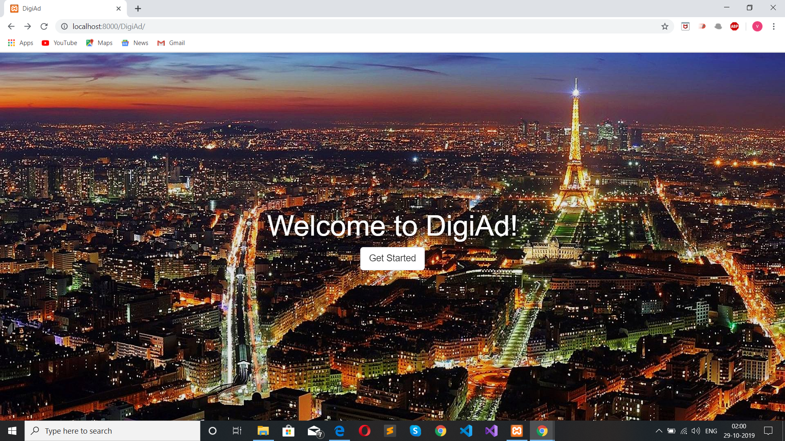

Slide 7
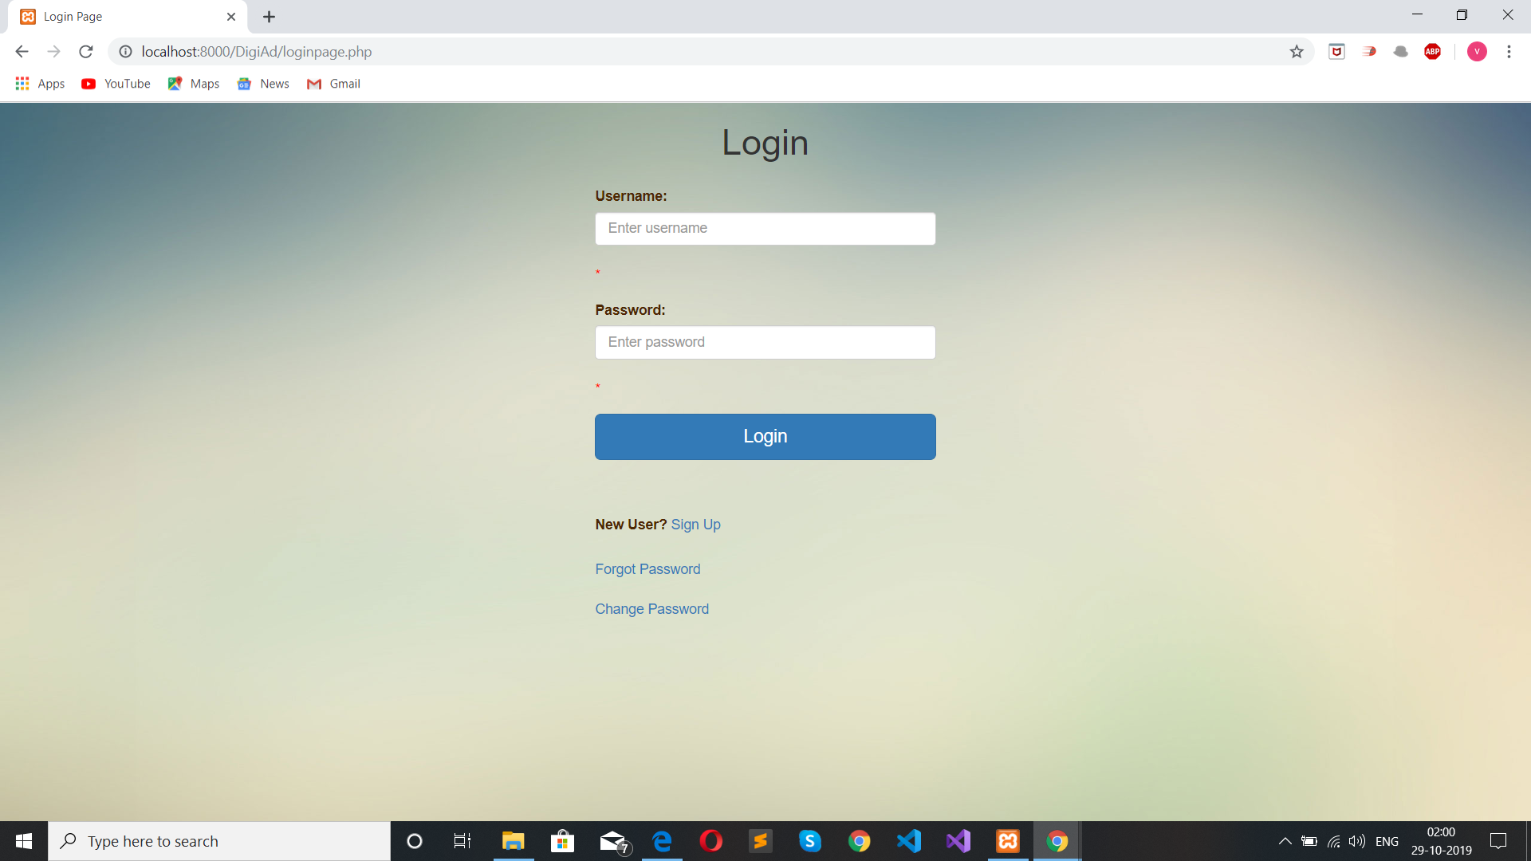
Login Page:

Slide 8
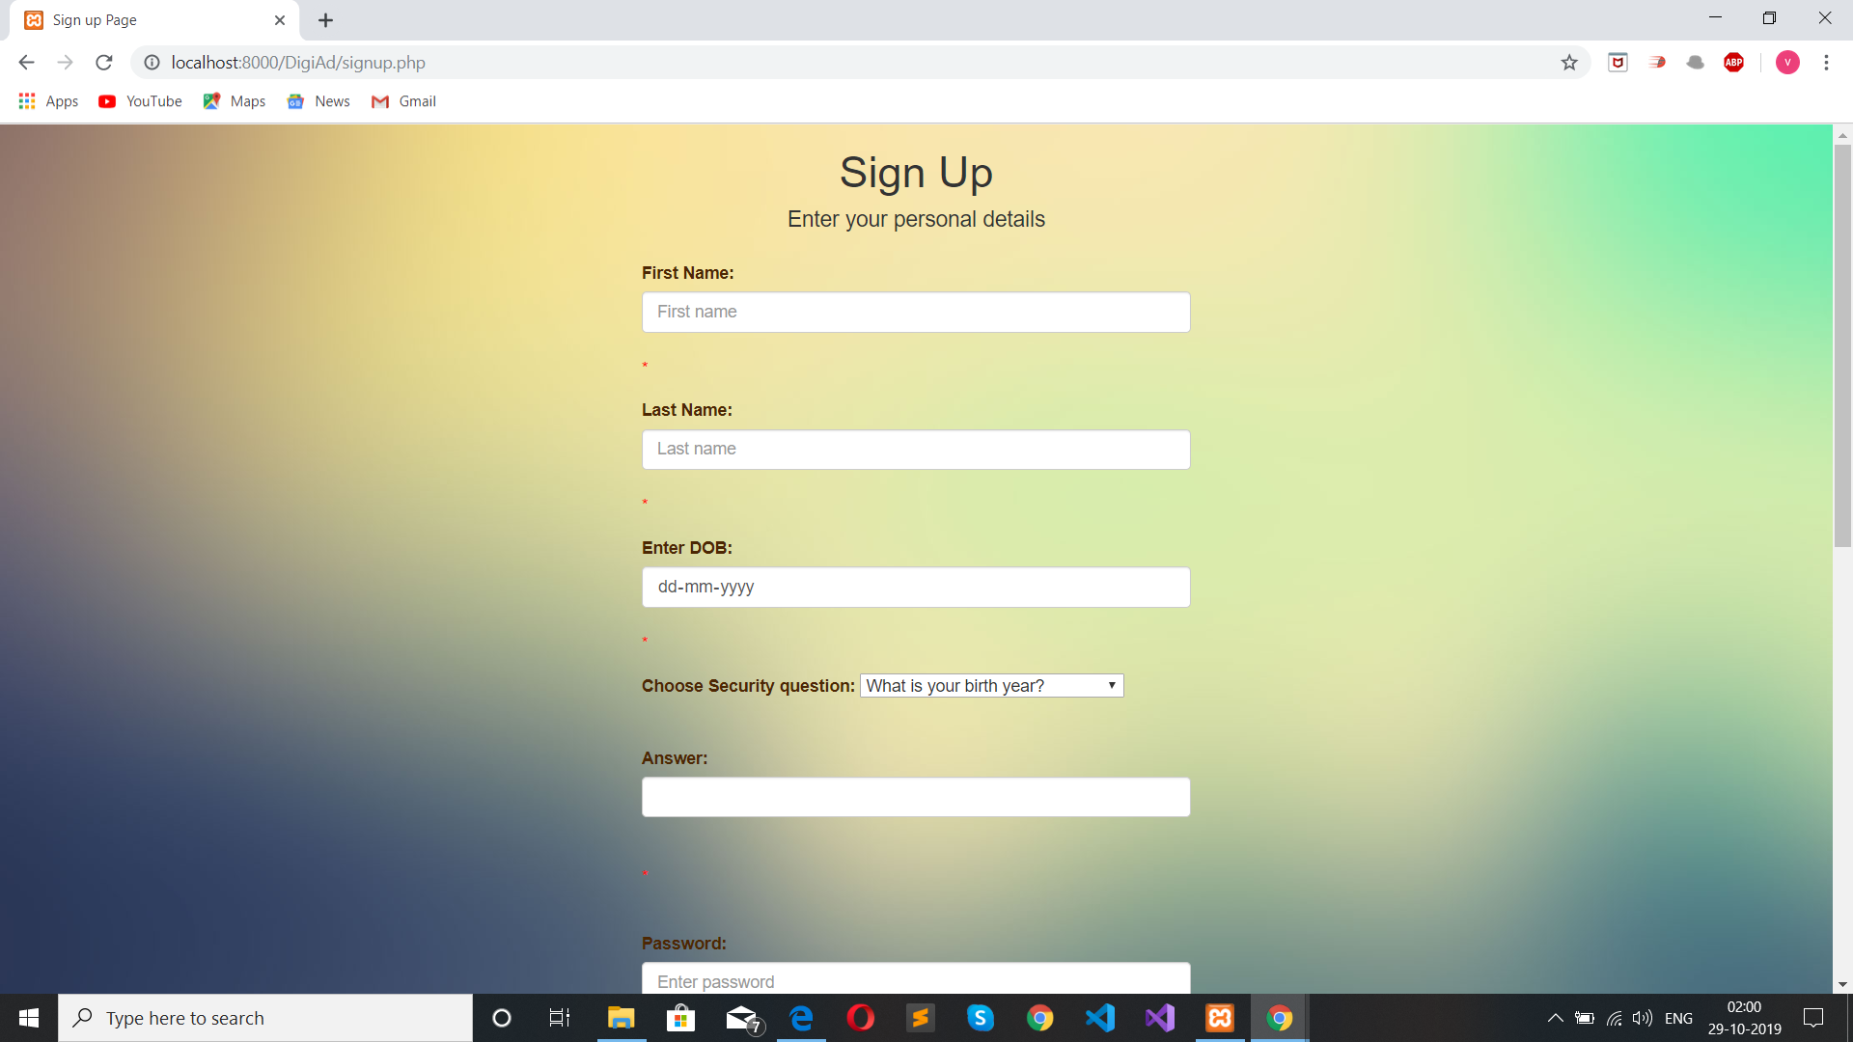
REGISTERING A NEW USER
ACCOUNT:

Slide 9

ACTIVITY FLOW IF SIGNED IN
AS USER:

Slide 10

ACTIVITY FLOW IF REQUIRED FIELDS ARE NOT ENTERED:

Slide 11
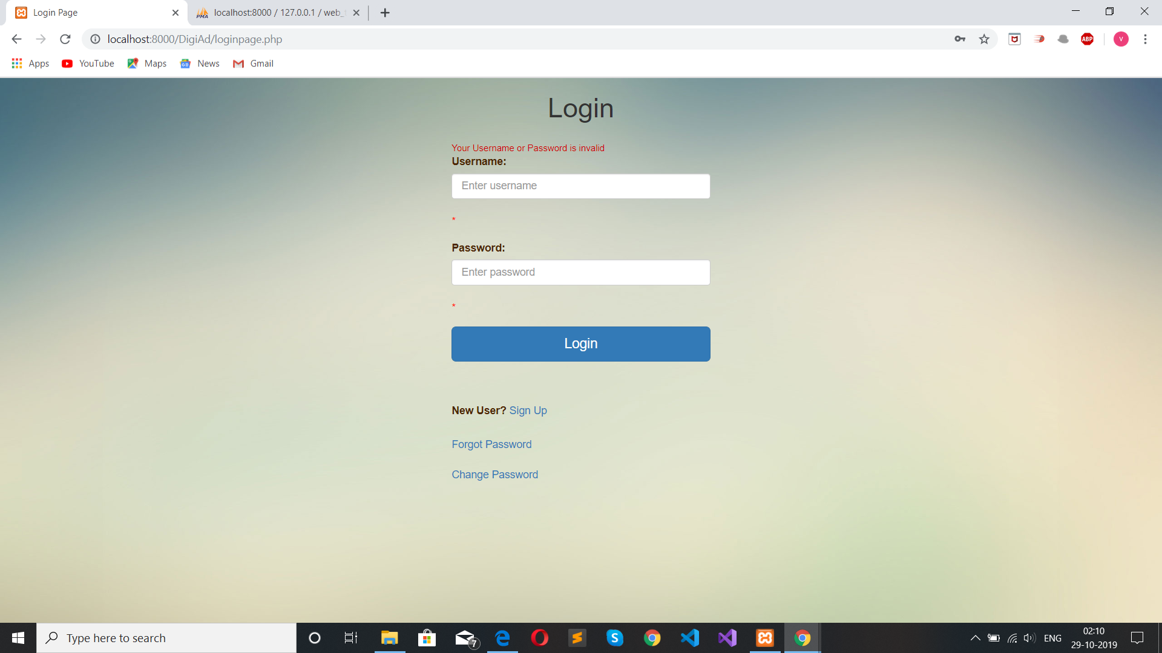
ACTIVITY FLOW IF USERNAME or PASSWORD is INVALID:

Slide 12
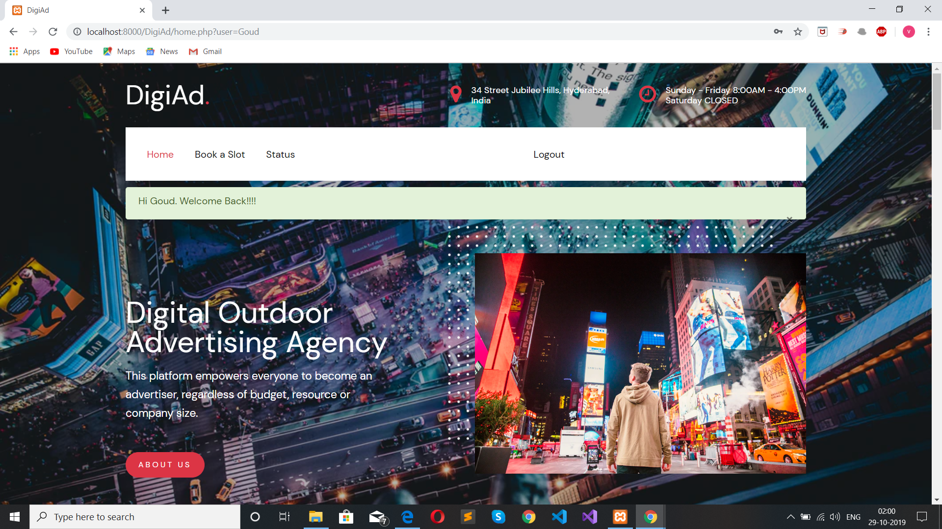
ACTIVITY FLOW IF SIGNED IN
AS USER: (HOME PAGE)

Slide 13
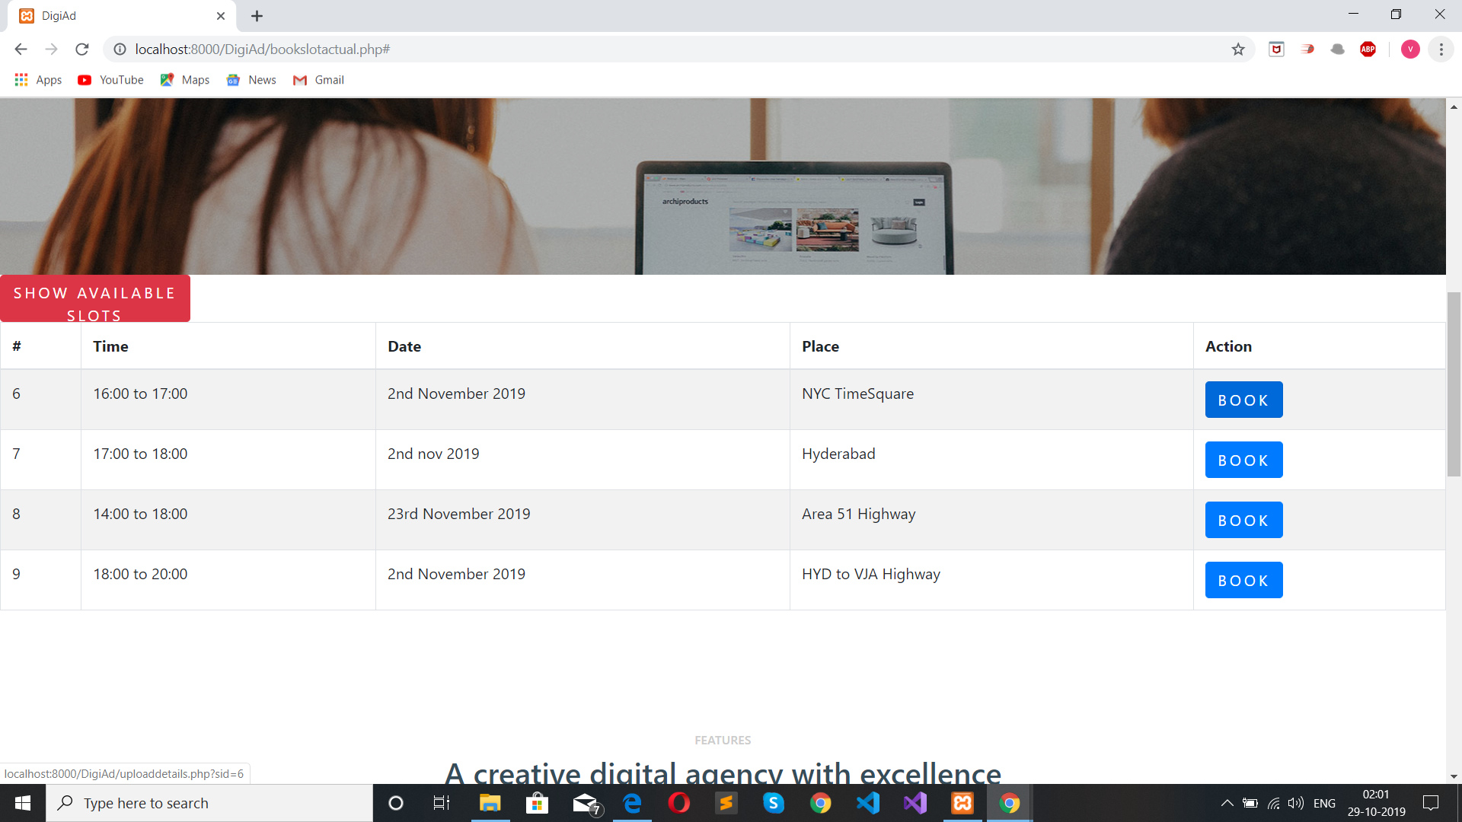
ACTIVITY FLOW IF SIGNED IN
AS USER: (BOOKING AVAILABLE SLOTS)

Slide 14
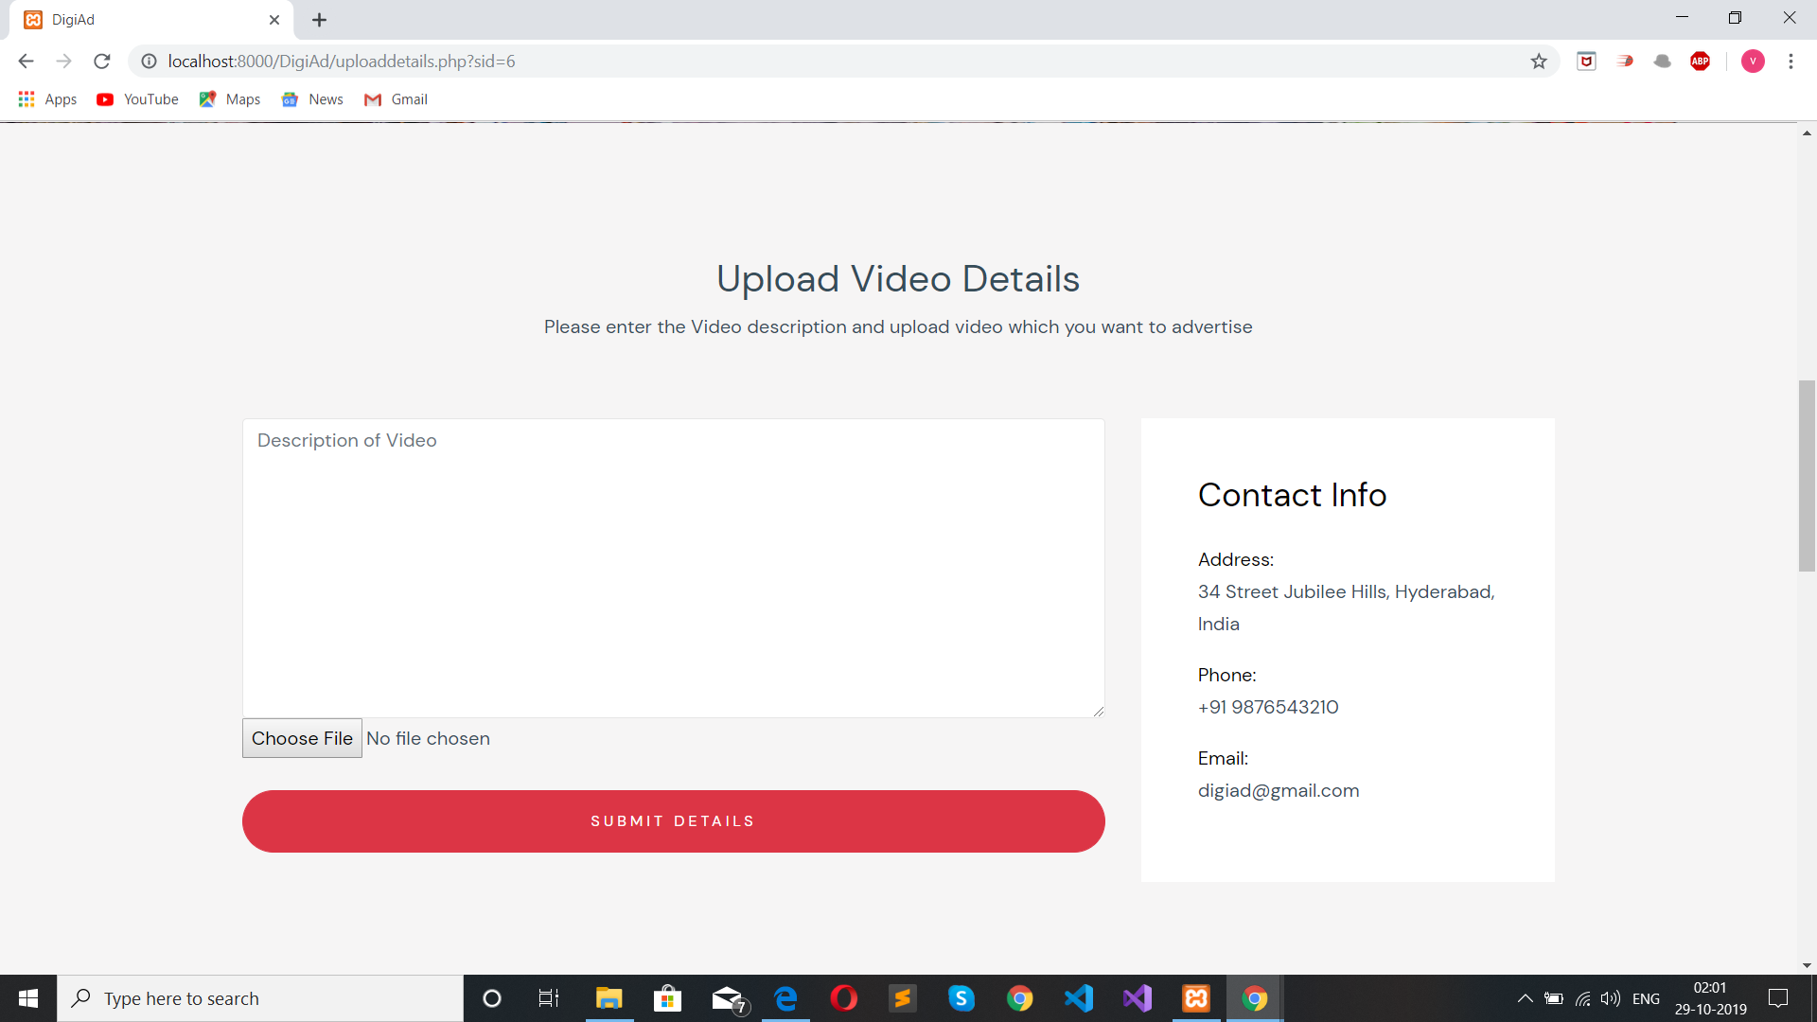
ACTIVITY FLOW IF SIGNED IN
AS USER: (UPLOADING VIDEO AND ITS DESCRIPTION)

Slide 15

ACTIVITY FLOW IF SIGNED IN
AS USER: (UPLOADING VIDEO AND ITS DESCRIPTION)

Slide 16
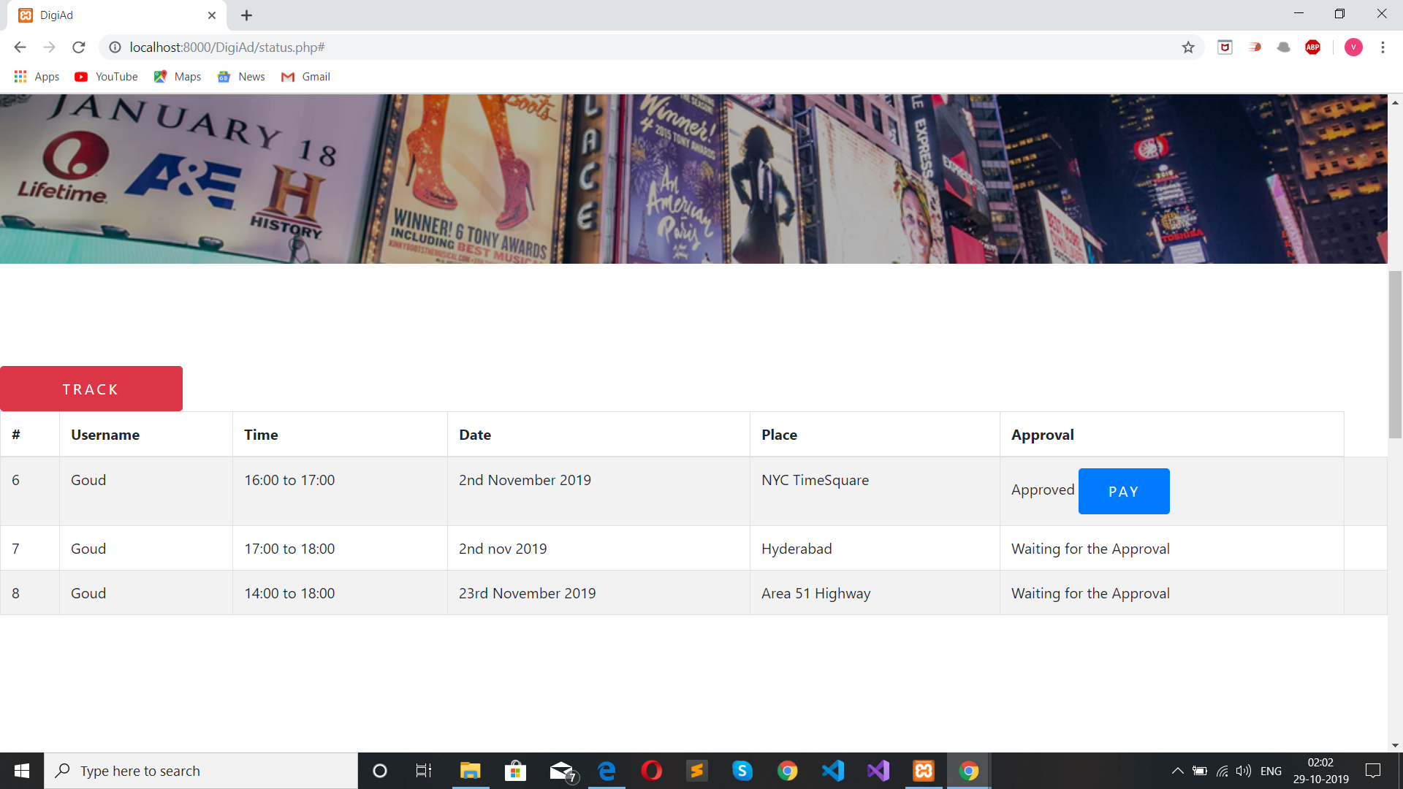
ACTIVITY FLOW IF SIGNED IN
AS USER: (TRACKING THE REQUESTED SLOTS WHETHER APPROVED OR NOT)

Slide 17

IF SIGNED IN AS ADMIN:

Slide 18
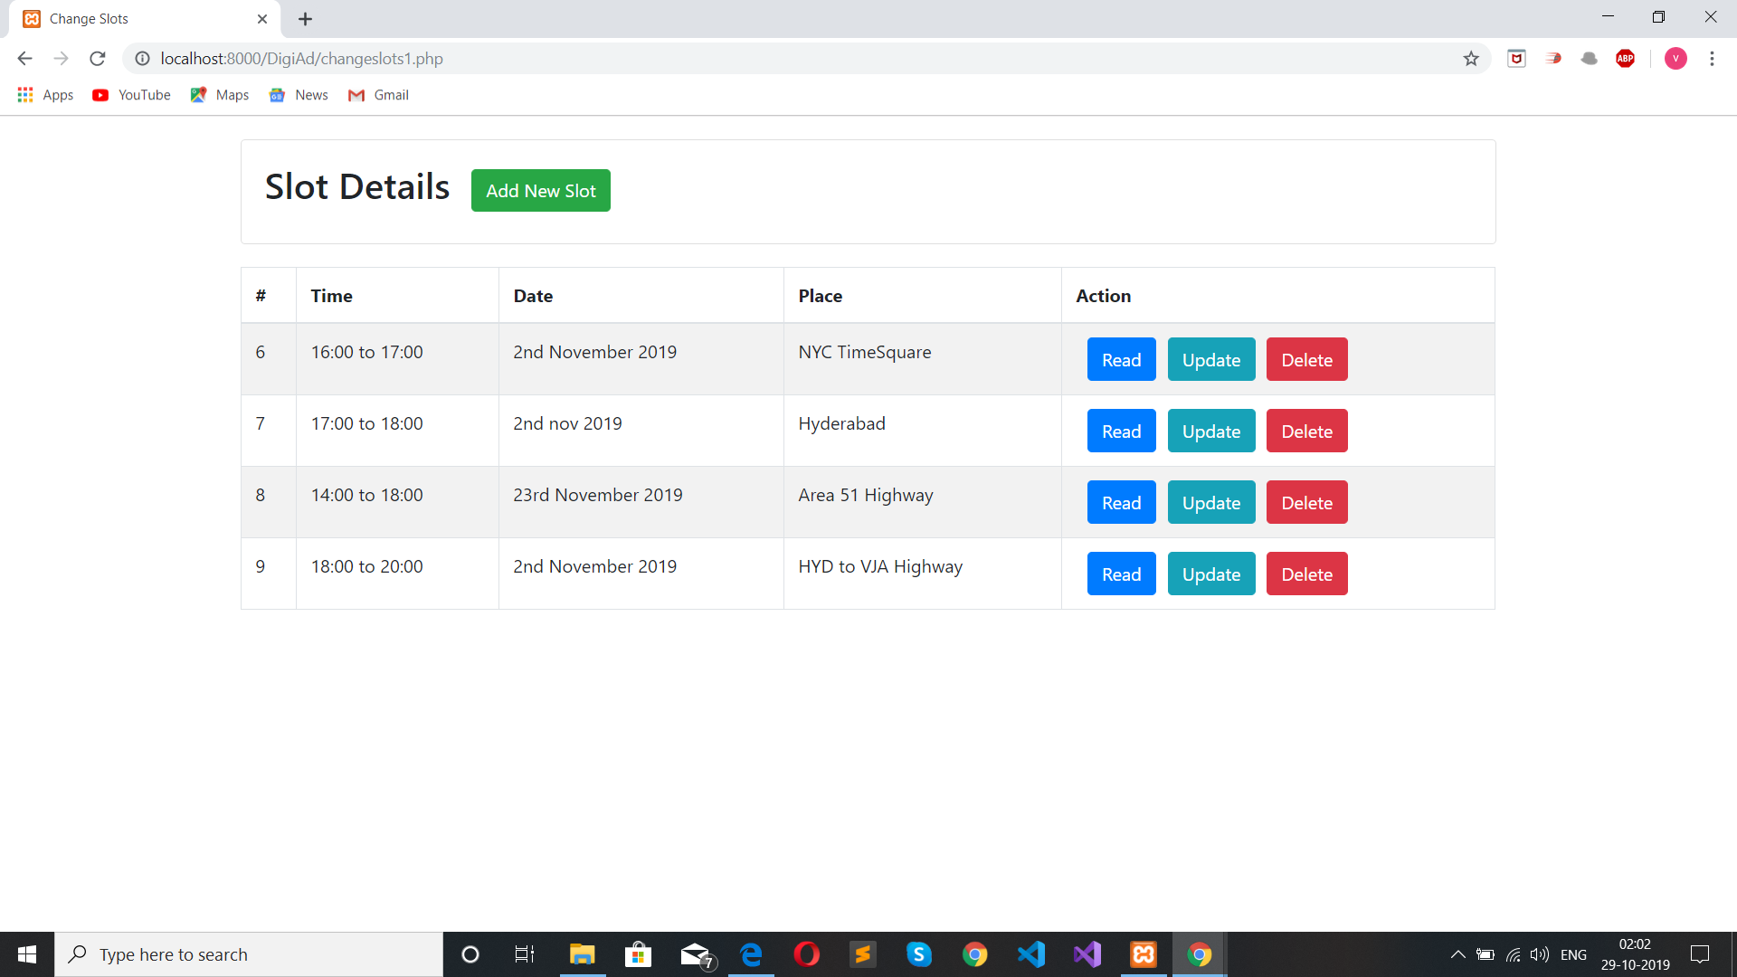
IF SIGNED IN AS ADMIN : (CHANGE SLOTS)

Slide 19
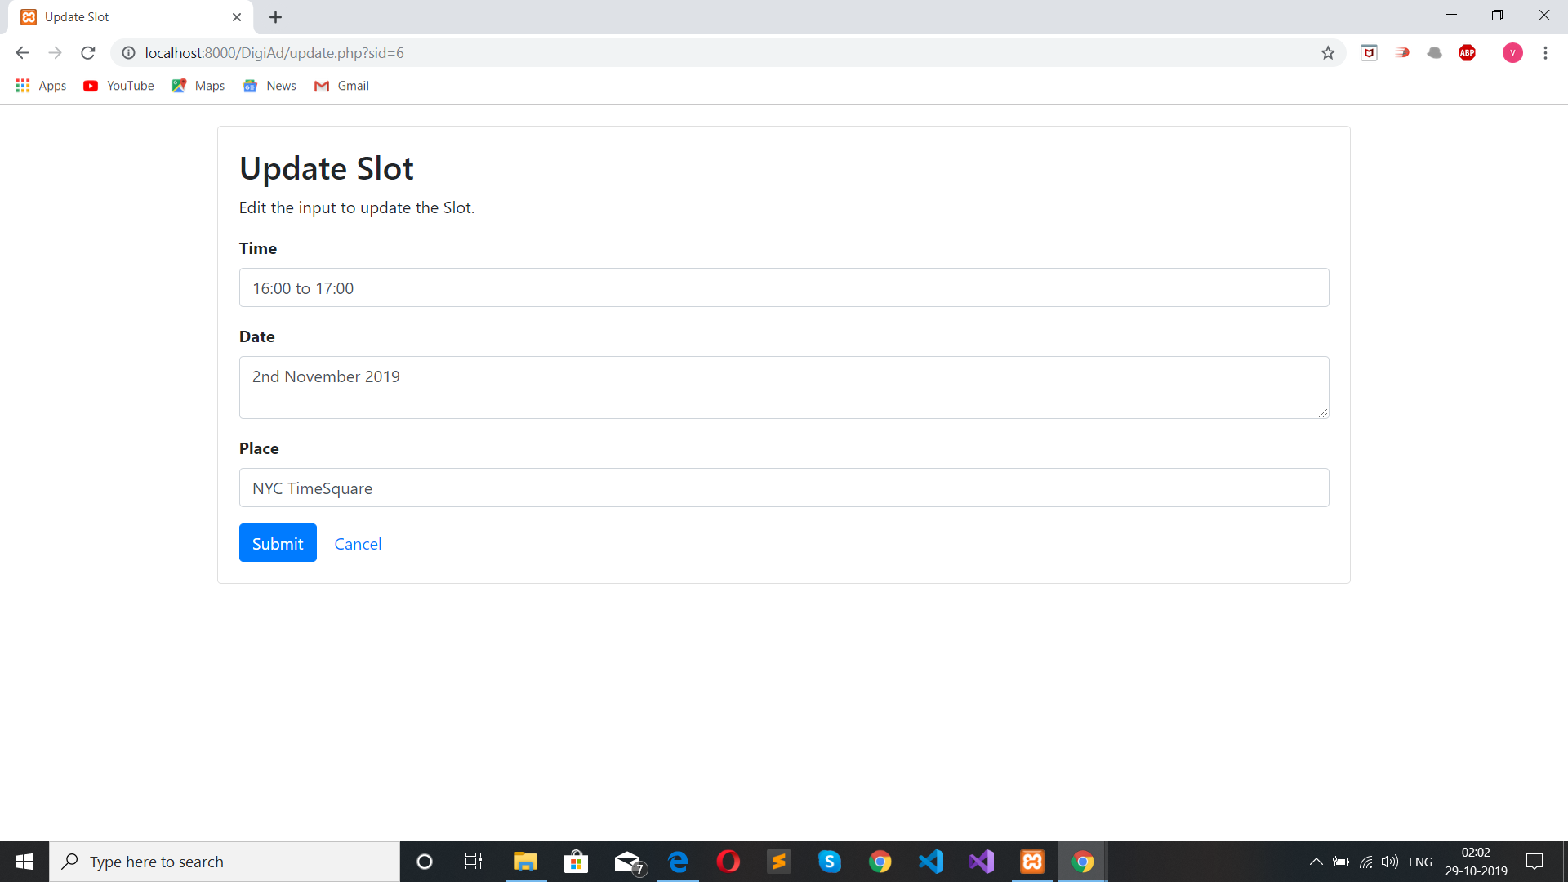
IF SIGNED IN AS ADMIN: (UPDATE/MODIFY SLOT)

Slide 20
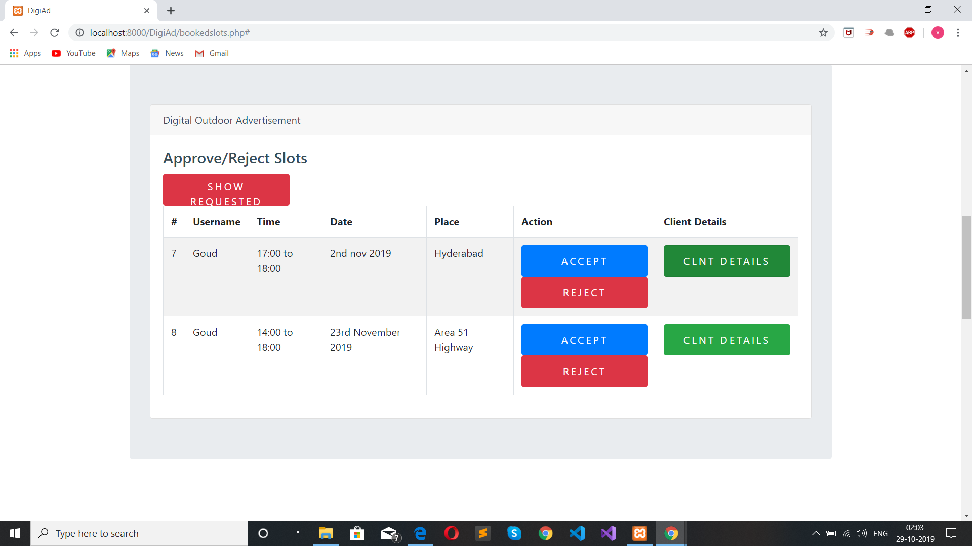
IF SIGNED IN AS ADMIN: (APPROVE OR REJECT REQUESTED SLOTS)

Slide 21
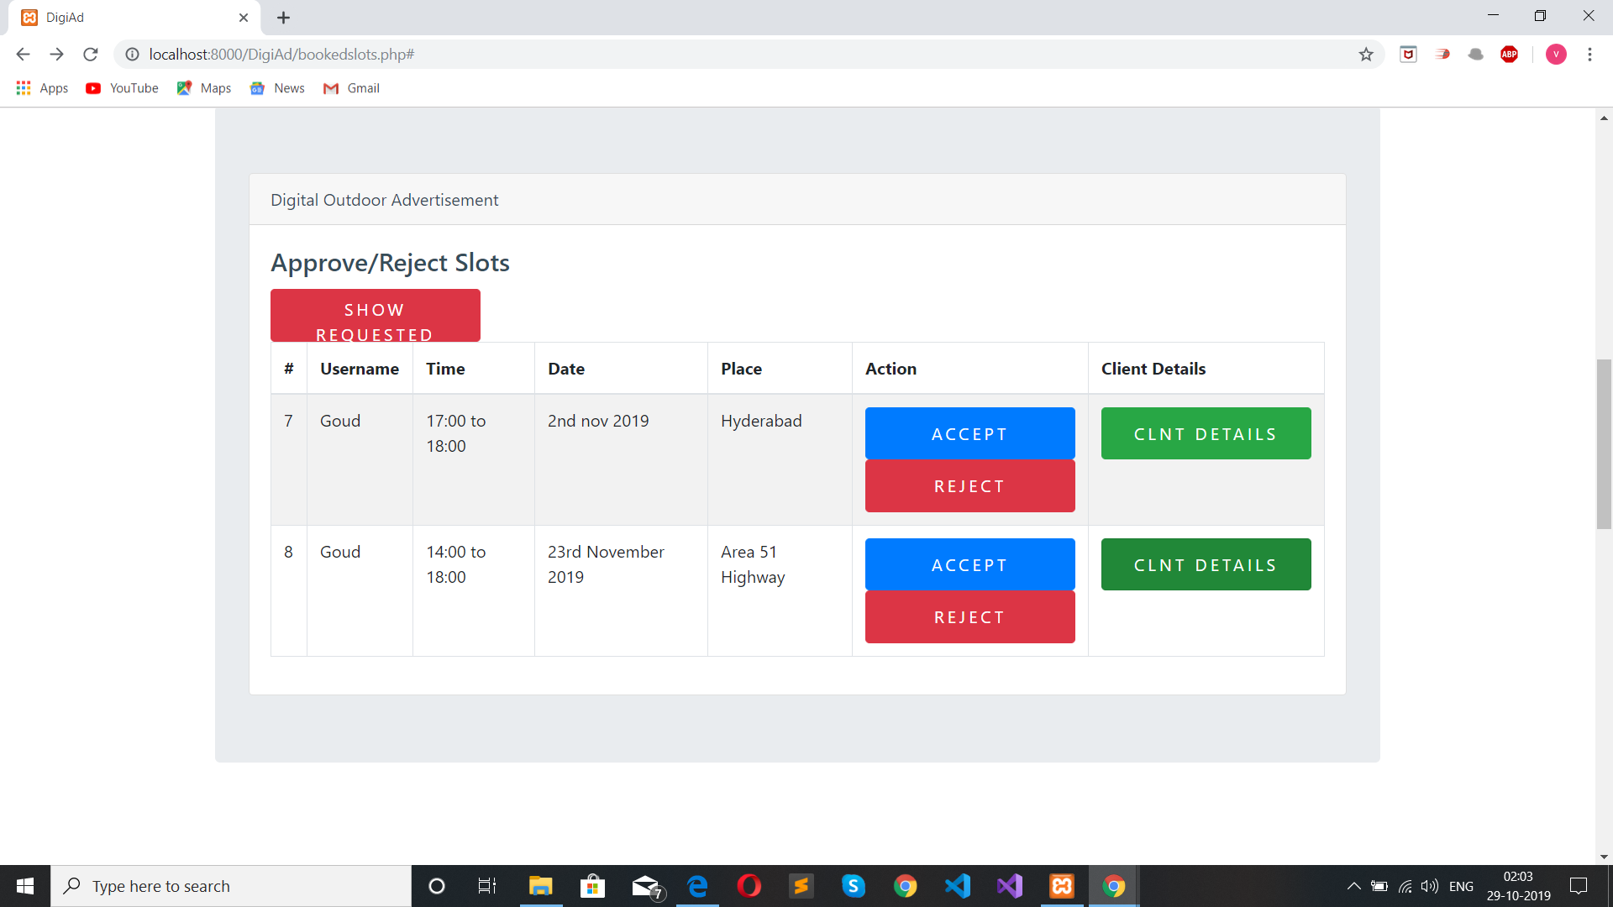
IF SIGNED IN AS ADMIN: (ACCEPTED SLOT)

Slide 22
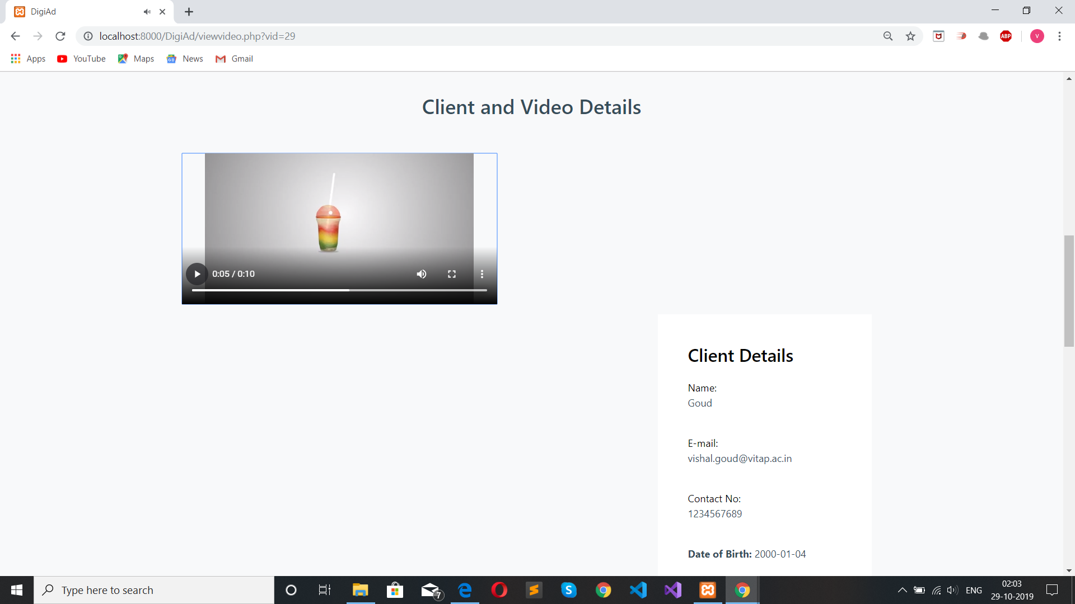
IF SIGNED IN AS ADMIN: (CLIENT AND VIDEO USER DETAILS)

Slide 23


Slide 24
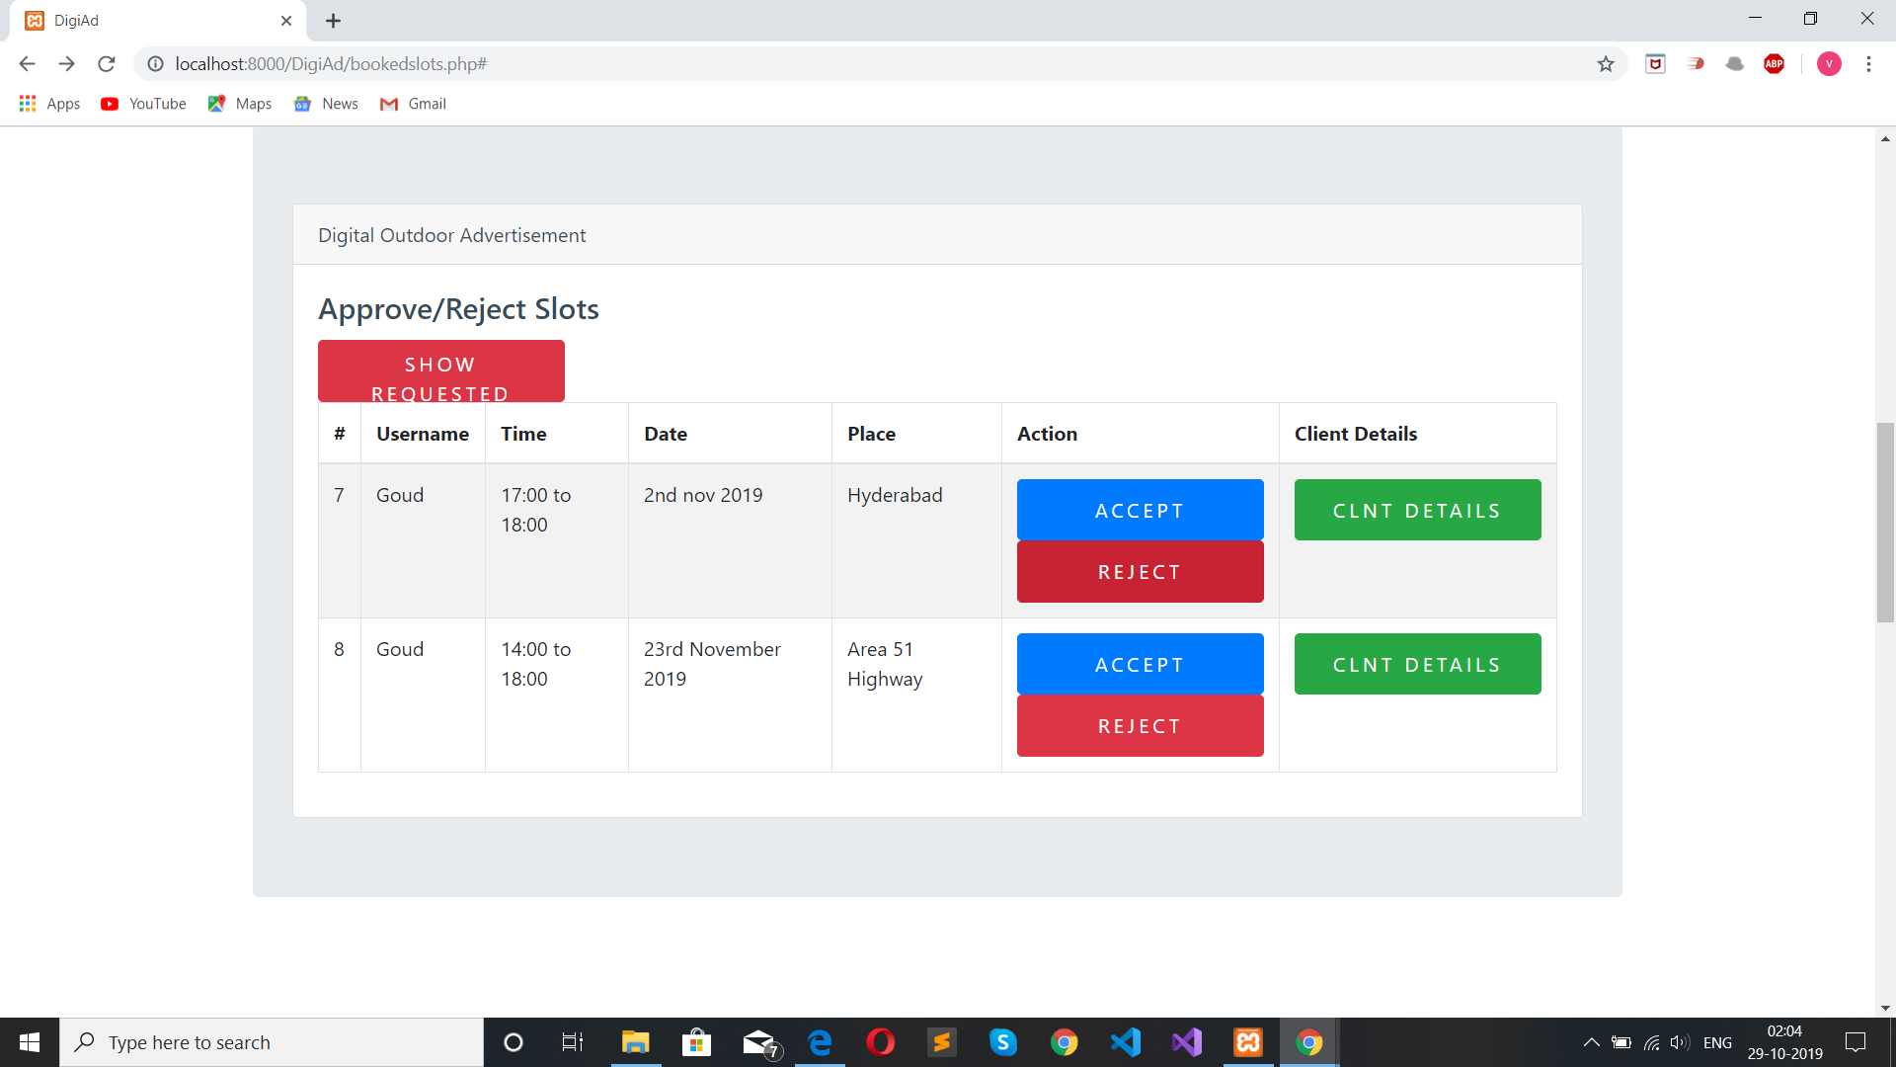

Slide 25
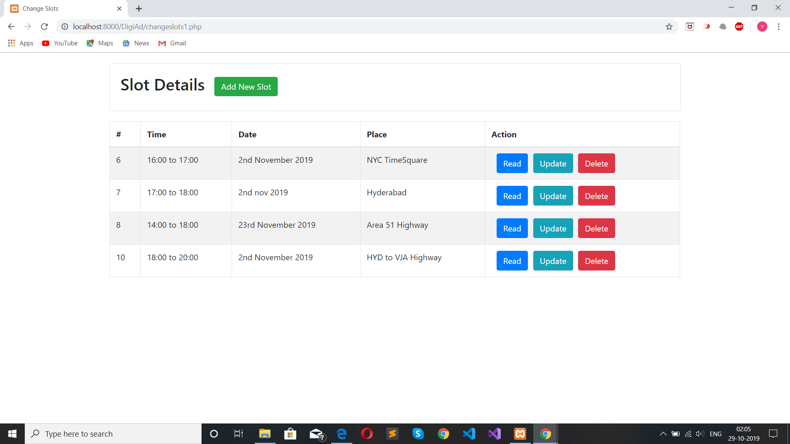

Slide 26
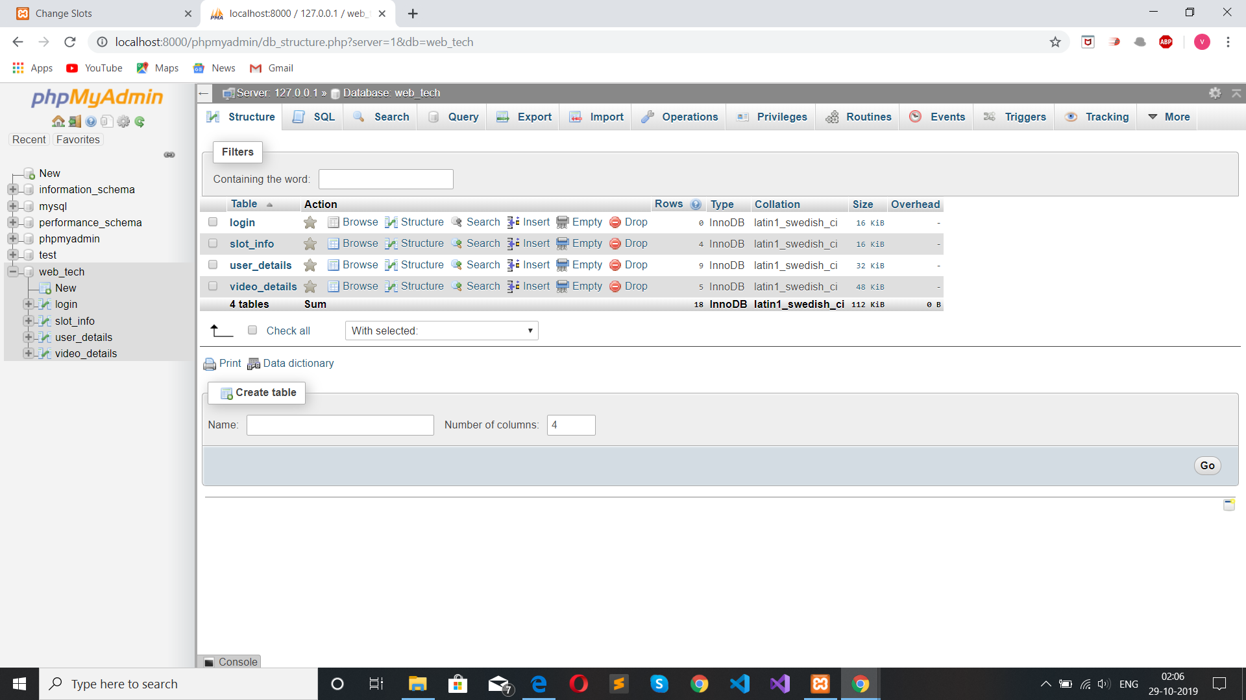
phpMyAdmin: (DATABASE)

Slide 27
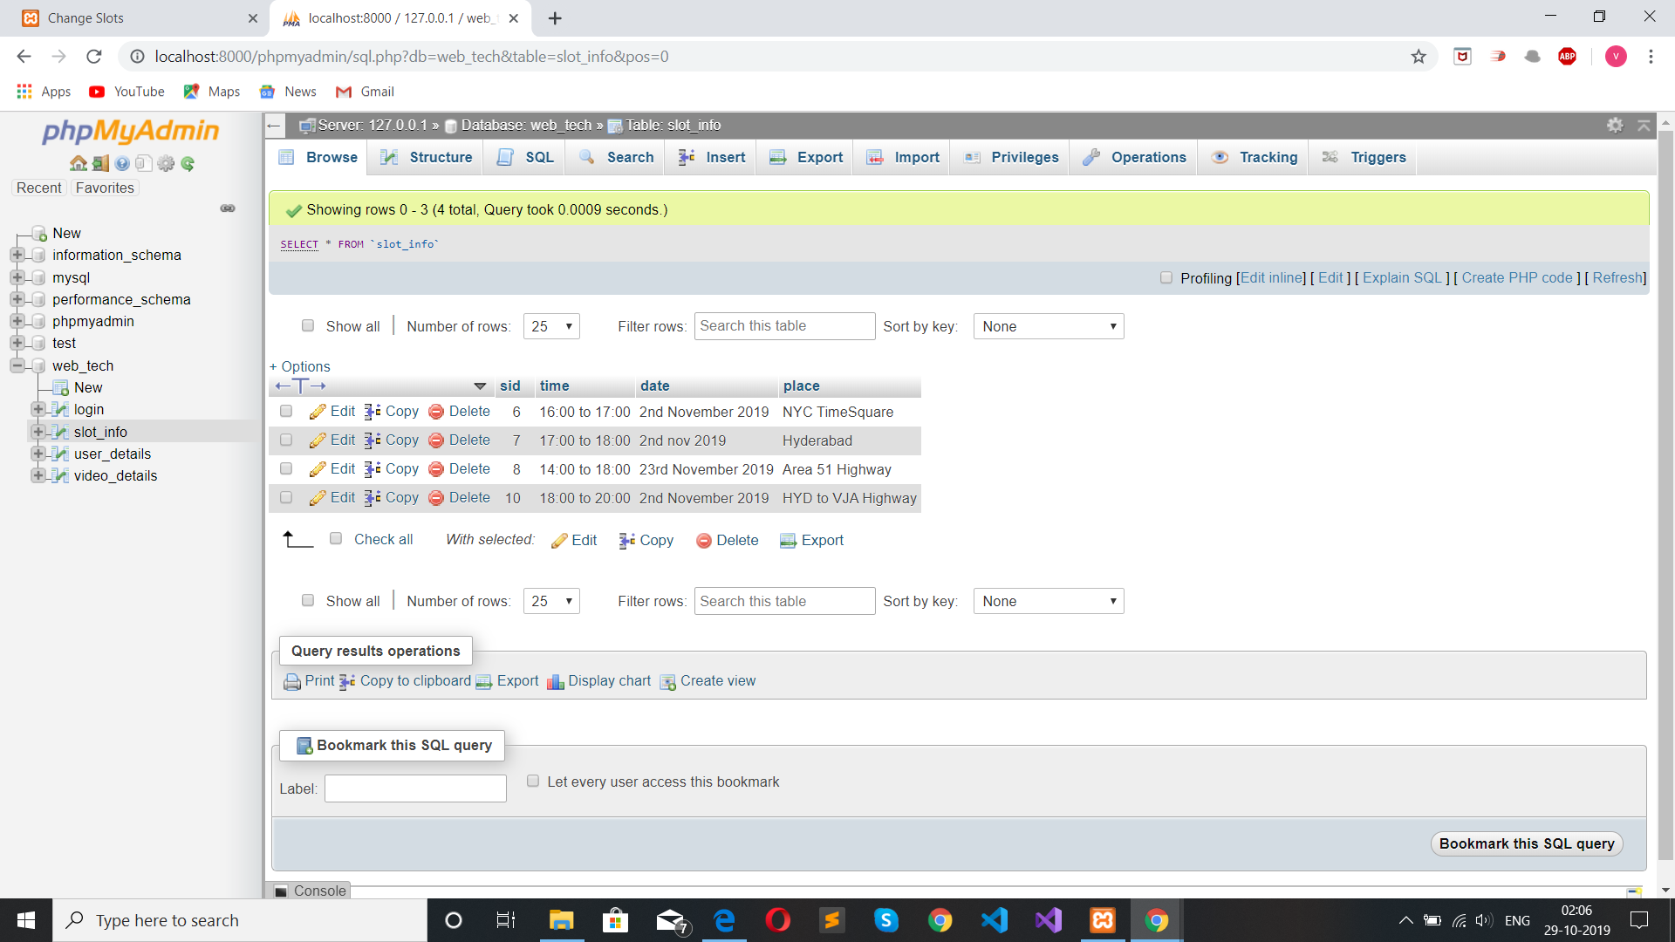
SLOT INFO TABLE

Slide 28
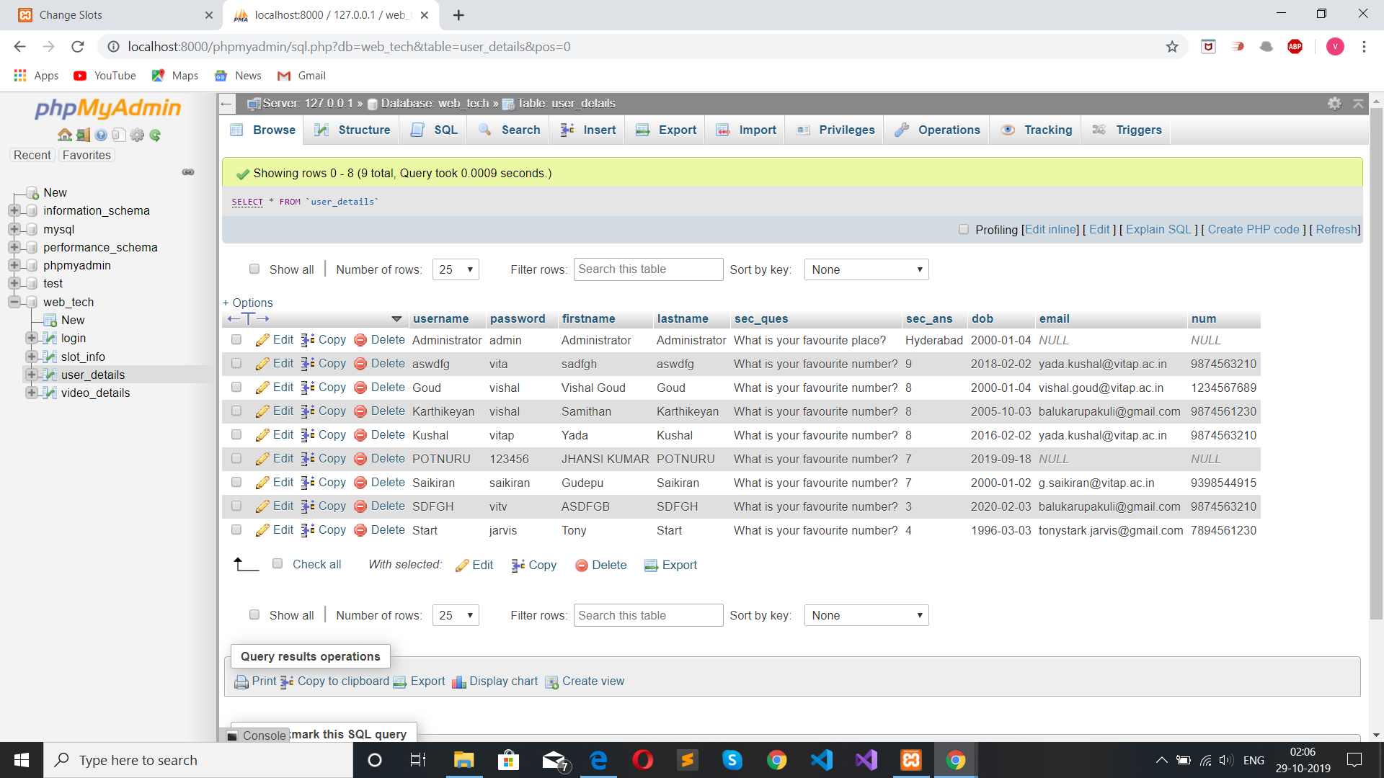
USER DETAILS TABLE:

Slide 29
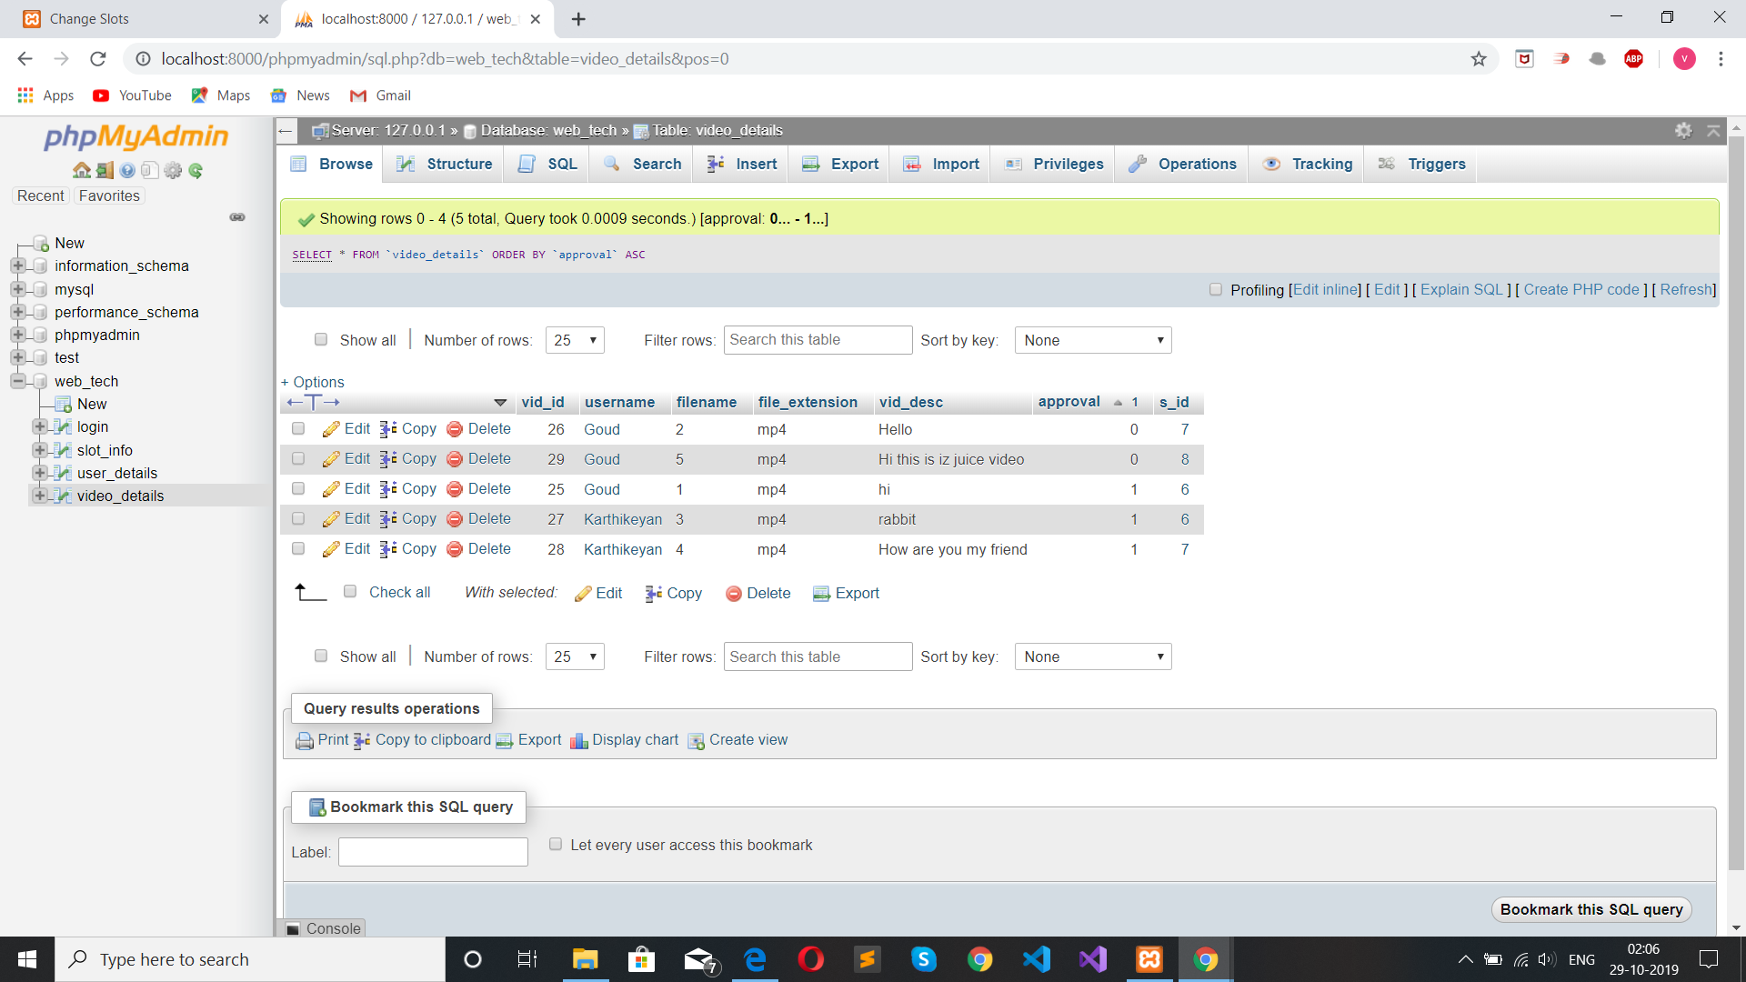
VIDEO DETAILS TABLE:

Slide 30
CONCLUSION AND FUTURE PLANS:
The main aspect behind Digital Outdoor Advertising is that it enabled us to bring out the new ideas that were sustained within us. This application offers the user to advertise their Product(or idea) easily and the content verification of the advertisement is personally checked by the Administrator of the application.
We have planned to add new technologies such as AR Reality and Trail Samples in future to this project.

Slide 31
TESTING

Slide 32
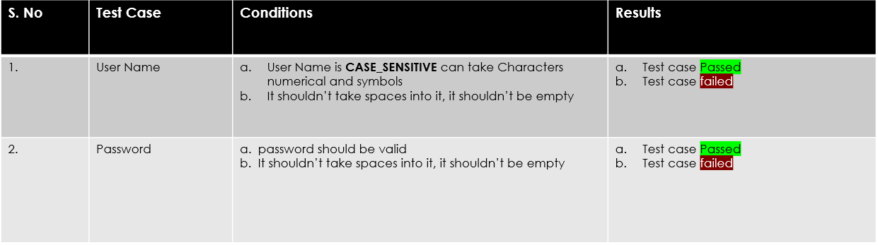
Testing Logic/Code writing
We are using SELENIUM for testing our modules:

Slide 33
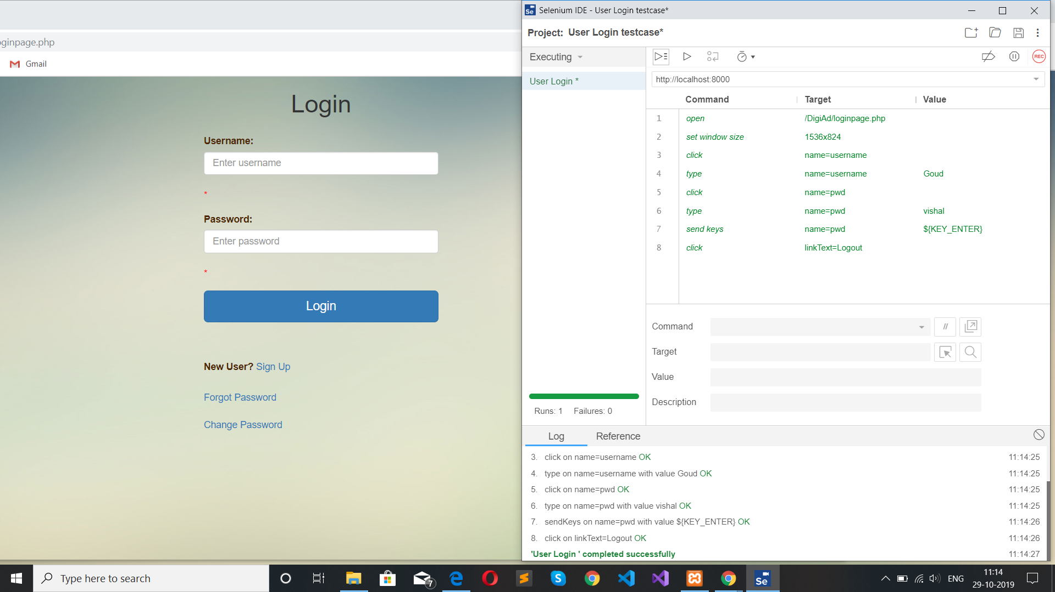
Login Test – User (Valid Credentials):

Slide 34
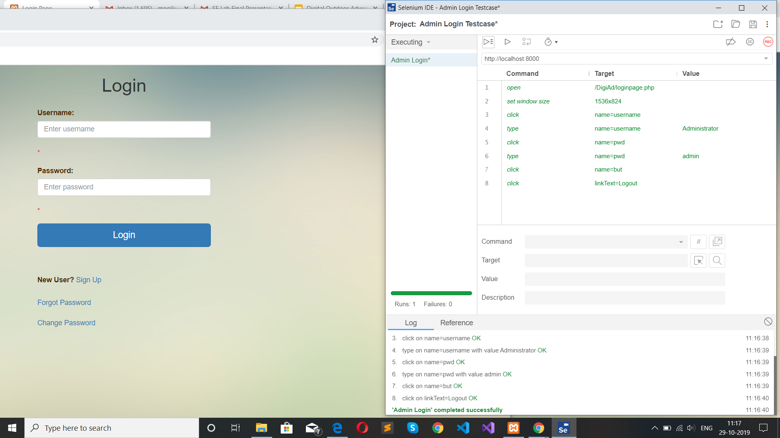
Login Test – Admin (Valid Credentials):

Slide 35
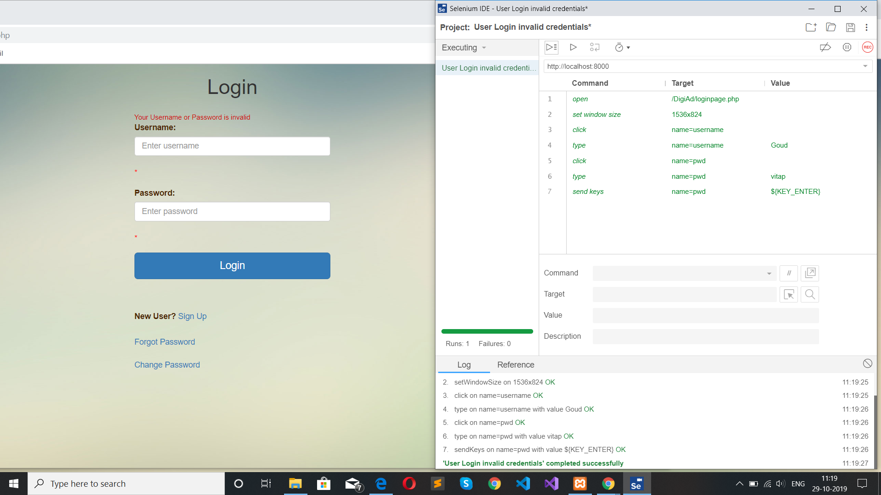
Login Test – User (Invalid Credentials):

Slide 36
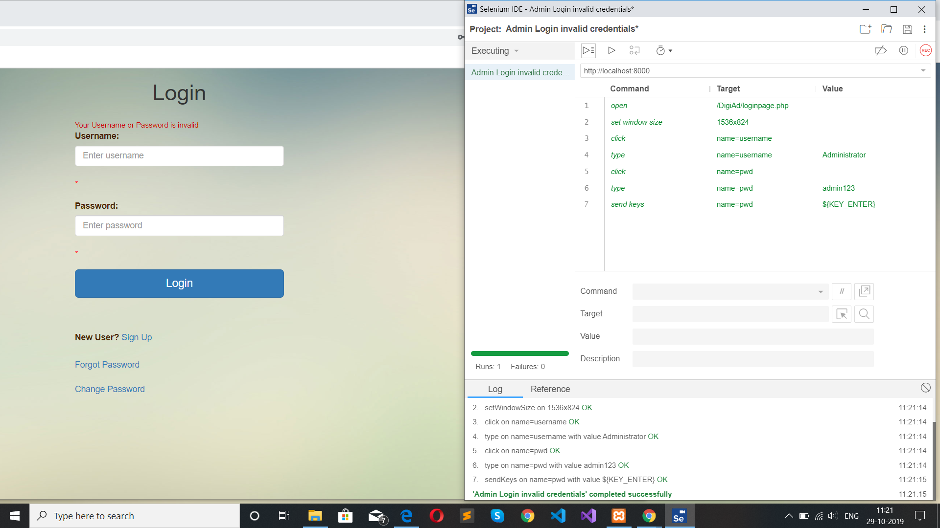
Login Test – Admin (Invalid Credentials):

Slide 37
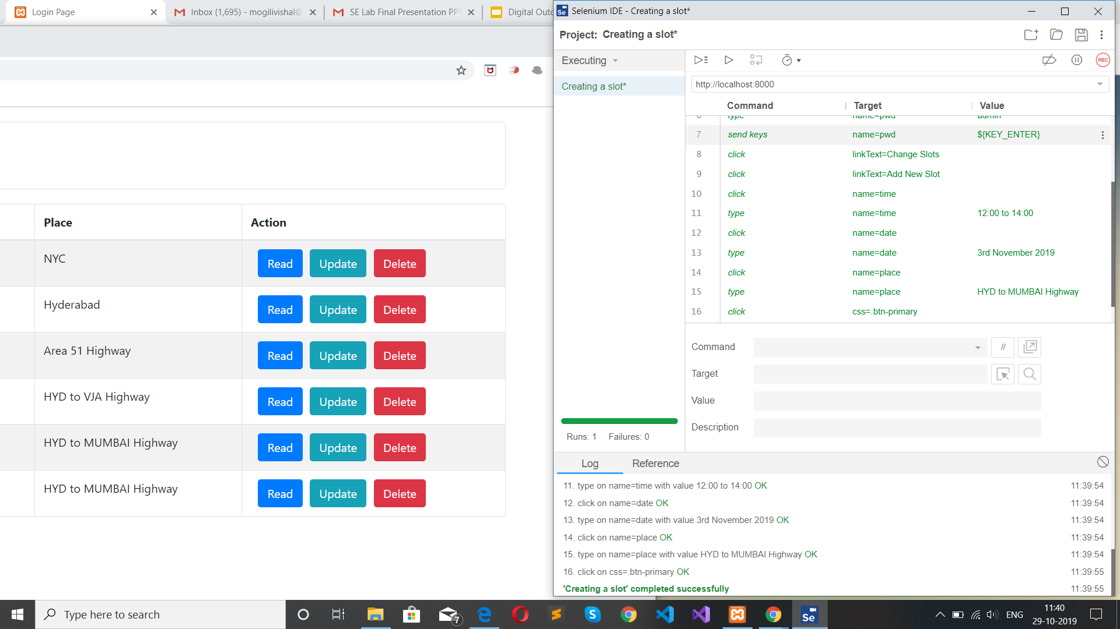
Booking a Slot Test:

Slide 38
Architecture Diagram
USER VERIFICATION
USER APPROVED
CHANGE BUTTON
DIGITAL OUTDOOR ADVERTISEMENT
PASS WILL BE CHANGED
KEYBOARD AND MOUSE
LOGIN INTO HOME PAGE
EXIT BUTTON
CLOSE THE SOFTWARE SYSTEM
DATABASE-
USERID DETAILS
DATABASE-
SLOT
DETAILS
DATABASE-
VIDEO DETAILS
VIDEO APPROVED
VIDEO VERIFICATION

Slide 39
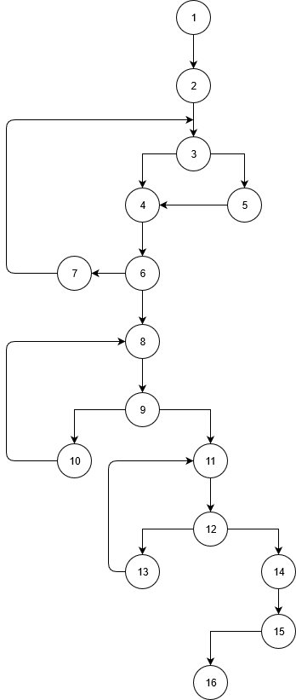
Cyclomatic Complexity V(G) = No. of regions = 5 V(G) = P+1 = 4+1 = 5 V(G) = E-N+2 = 19-16+2 = 5

Slide 40
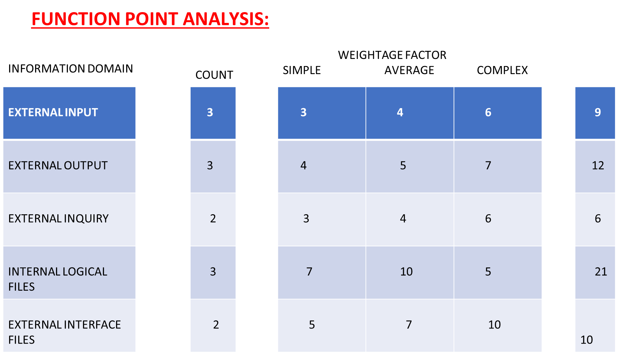

Slide 41
FUNCTION POINT ANALYSIS:
FP= COUNT * (0.65+0.01* ∑(fi))
HERE,
COUNT = 58
∑(fi)= 14*1 = 14
FP = 58*(0.65+0.01*14)
FP = 45.82 ~= 46
Total ESTIMATED LOC = 2500.

Slide 42
ESTIMATION TECHNIQUES – LOC APPROACH:
BURDENED LABOUR RATE : $8000
AVERAGE PRODUCTIVITY : 2500/5 = 500
COST PER LOC : LABOUR RATE/AVG PRODUCTIVITY
:$8000/500
:APPROX $16
TOTAL PROJECT COST :COST PER LOC*ESTIMATED LOC
:$16*2500
:$40,000
ESTIMATED EFFORT : TOTAL PROJECT COST/LABOUR RATE
:$40,000/$8000
: 5 PERSON/MONTH

Slide 43
FP APPROACH:
APPROXIMATE COST PER FP : LABOUR RATE/AVG PRODUCTIVITY
: $8000/6
:$1,333
TOTAL ESTIMATED COST : FP ESTIMATED*APPROX(COST PER FP)
: 46*$1,333
:$ 61,318
ESTIMATED EFFORT : ESTIMATED COST/LABOUR RATE
: $61,318/8000
: APPOX 8 PERSONS/MONTH
Productivity = 2.4*[(2.5)^1.05]
= 6.28
= Approx. 6 p-m

Slide 44
UML DIAGRAMS

Slide 45
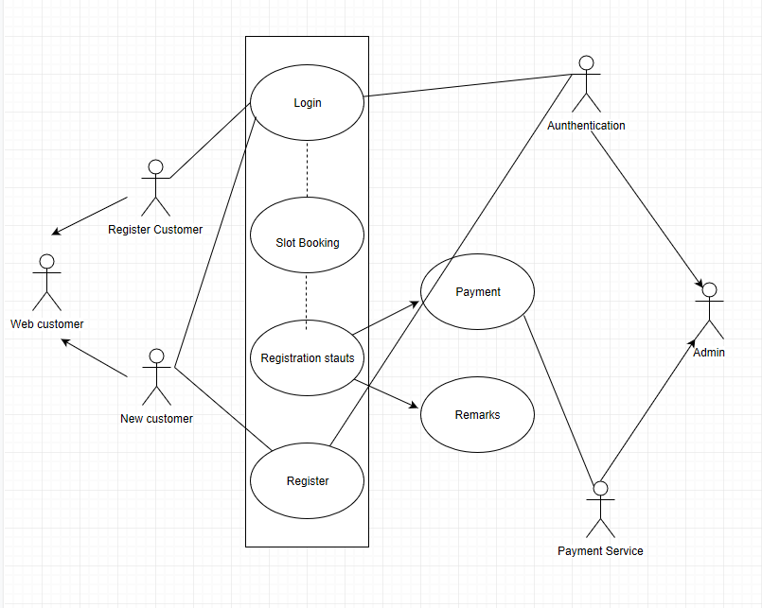

Slide 46
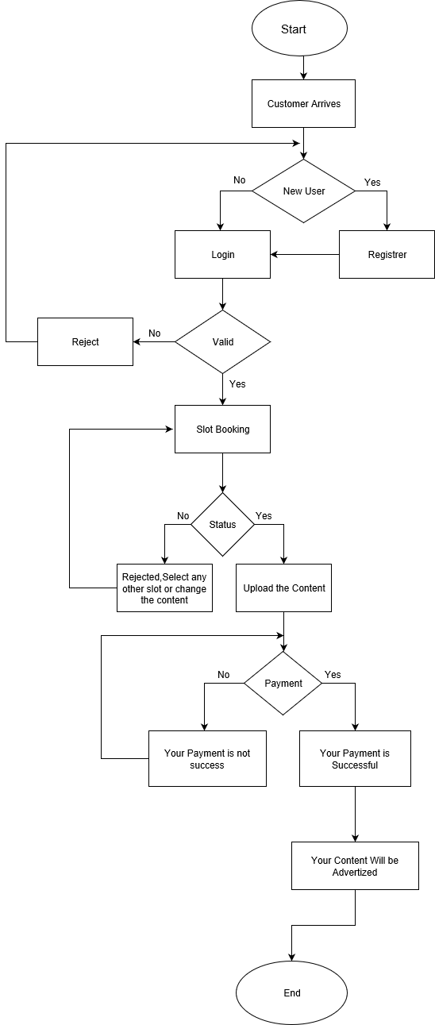

Slide 47
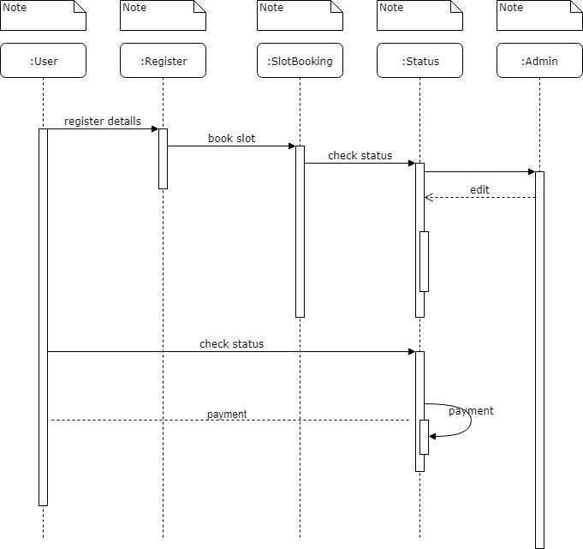

Slide 48
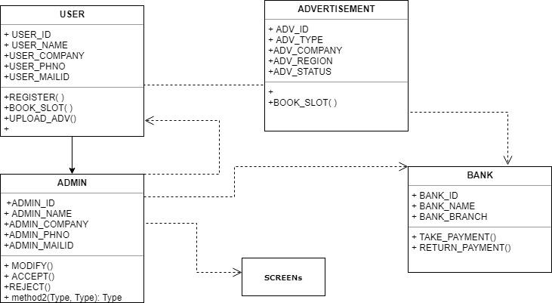

Slide 49
Challenges faced during Development
Updation of Available slots in user page when admin accepts/rejects slots
Uploading Video details into the database

Slide 50

THANKYOU…

